Slide 1
Data Dive 4: EPL Edition
By: Ryan, Armia, Kevin, David N

Slide 2
What we set out to Answer
What characteristics (goals scored, points gained) does each position in the league tend to have?
Did any teams tend to finish in one position compared to another place?
How have the top teams performed specifically in the league?

Slide 3

Background Information
Highest ranking league in England
Consists of 20 teams
Each team plays 38 matches each season.
Point system per match
Premier League Title

Slide 4
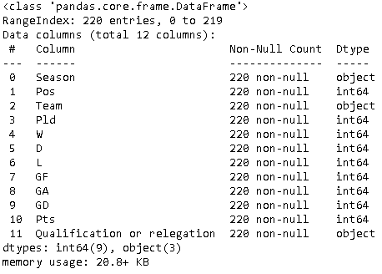
The Dataset: EPL Standings 2010-2021
Clean Data Set
11 Seasons
Analyze goals scored, goals allowed, and goal differential
Incentive to place high on the standings to avoid relegation

Slide 5
Promotion and Relegation
Different Leagues
Promotion is when a team rises up a League
Relegation is when a team moves down a league
Top 3 teams get “promoted” at the end of the season to the next high league
Bottom 3 teams get “relegated to the next lowest league
This keeps both sides of the league interesting and has major impacts on viewership, popularity, and overall revenue as well

Slide 6

English Football League Championship
The second highest league in the English football system
Consists of 24 teams in the league
Follows the same scoring rules as the Premier League
Top 2 teams automatically advance to the Premier League
Teams 3-6 face off to determine the 3rd spot to advance to the Premier League
Bottom 3 teams move down to English Football League One

Slide 7
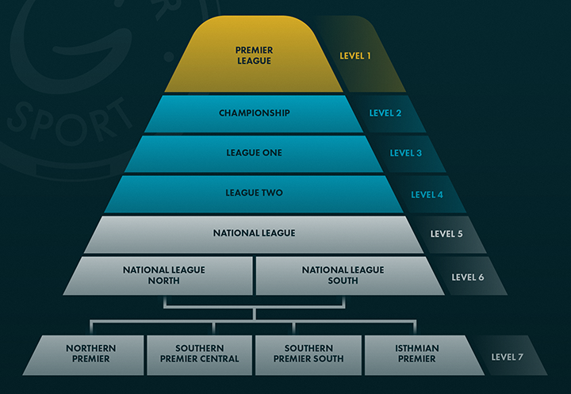

Slide 8
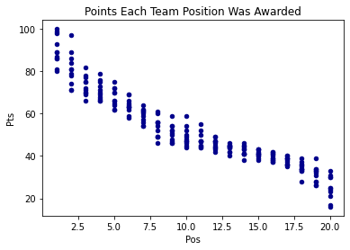
Points Each Team Position Was Awarded
There is a negative correlation between the points and team position
It also looks there is a bigger range of variability in the higher position versus the lower position
A range of points awarded is visible for each team position

Slide 9
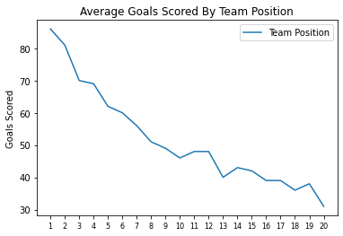
How Many Goals Does Each Team Position Usually Score?
Position 1 scored 86 goals on average.
Position 20 scored 31 goals on average.

Slide 10
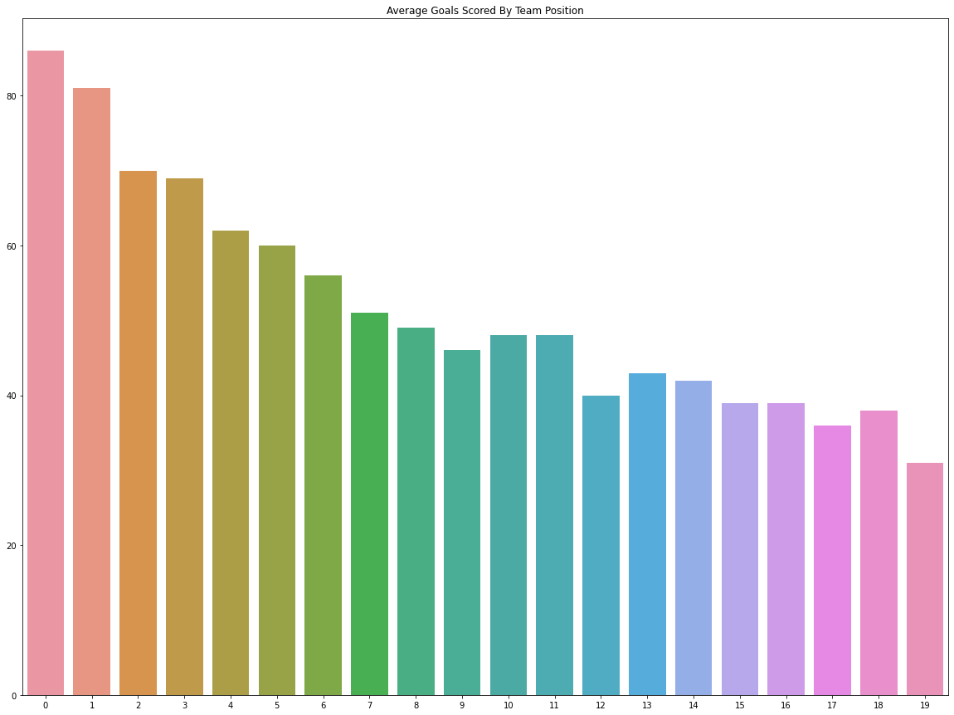

Slide 11
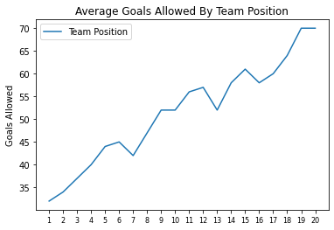
How Many Goals Does Each Seed Usually Allow?
Position 1 allowed 32 goals on average.
Position 20 allowed 70 goals on average.

Slide 12
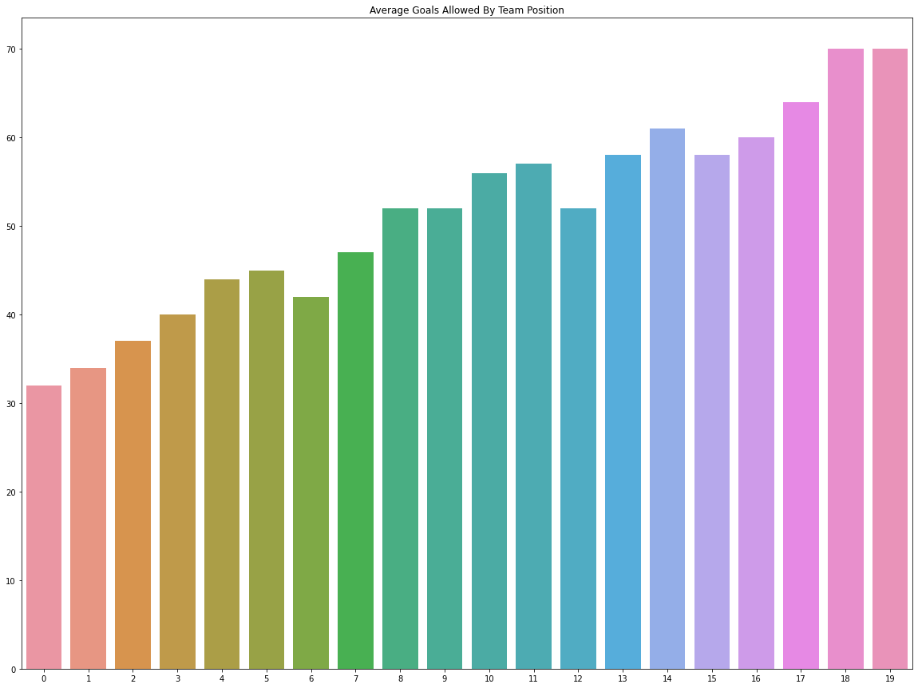

Slide 13
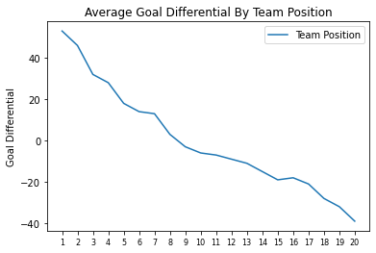
What Is The Goal Differential For Each Team Position?
Position 1 had a goal differential of 53 on average.
Position 20 had a goal differential of -39 on average.

Slide 14
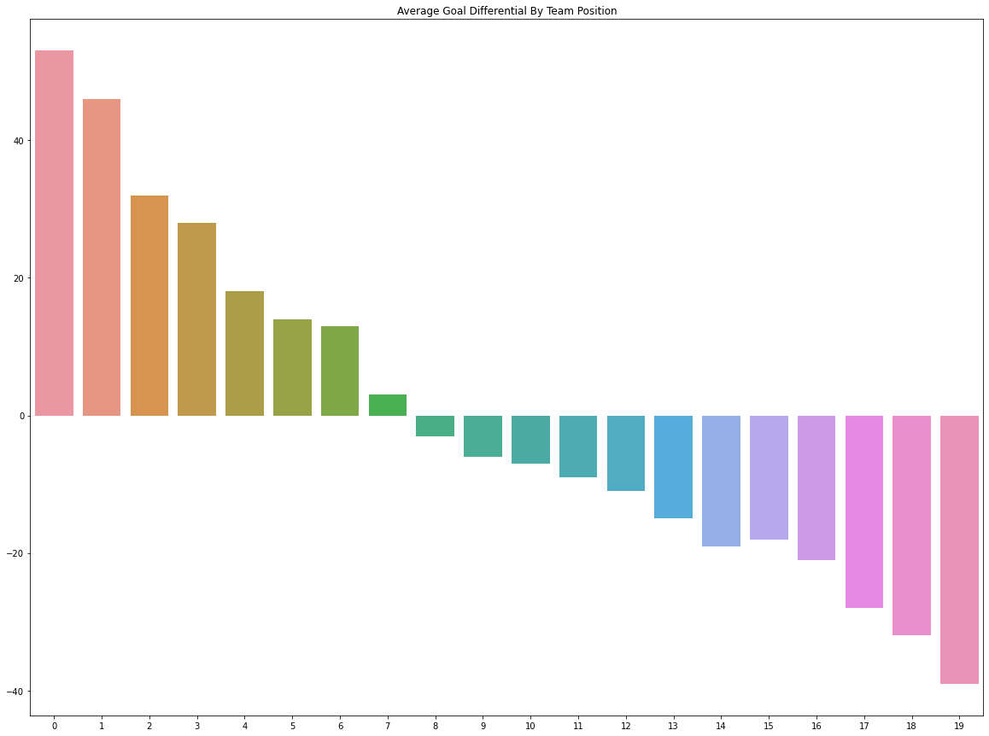

Slide 15
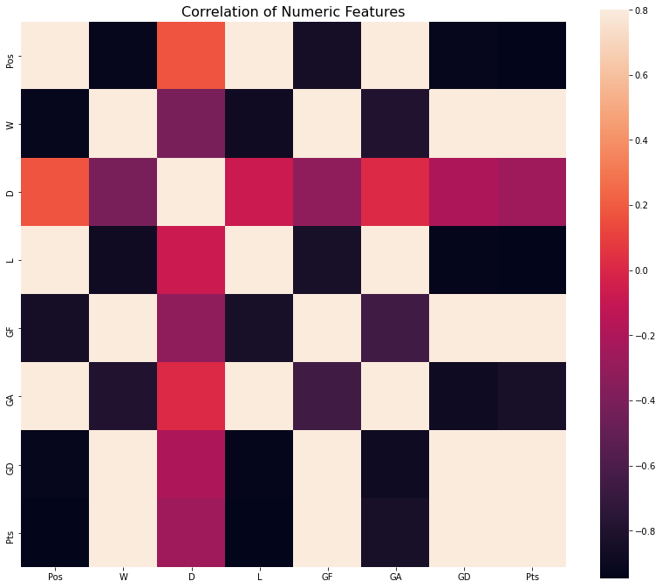

Slide 16
Champions League Group Stage Teams
Team | Number of Appearances
Manchester City | 10
Chelsea | 9
Manchester United | 7
Liverpool | 5
Tottenham Hotspur | 4
Arsenal | 3
Leicester City | 1

Slide 17
Europa League Group Stage Teams
Team | Number of Appearances
Arsenal | 4
Leicester City | 2
Manchester United | 2
Tottenham Hotspur | 2
Chelsea | 1
Team | Number of Appearances
Everton | 1
Liverpool | 1
Southampton | 1
West Ham United | 1
Wigan Athletic | 1

Slide 18
Relegation Teams
Team | Number of Appearances
Fulham | 3
Norwich City | 3
West Bromwich Albion | 2
Cardiff City | 2
Hull City | 2
Queens Park Rangers | 2
19 Teams | 1

Slide 19
Most Common Teams Per Final Position
Manchester City (5)
Manchester United (3)
Chelsea (3)
Arsenal (3)
Tottenham Hotspur (3)
Three teams tied (2)
Everton (3)
Four teams tied (2)
Stoke City (3)
Three teams tied (2)
Two teams tied (2)
Two teams tied (2)
Stoke City (3)
Crystal Palace (3)
Two teams tied (2)
Eleven teams tied (1)
Two teams tied (2)
Hull City (2)
Fulham (2)
Queens Park Rangers (2)

Slide 20
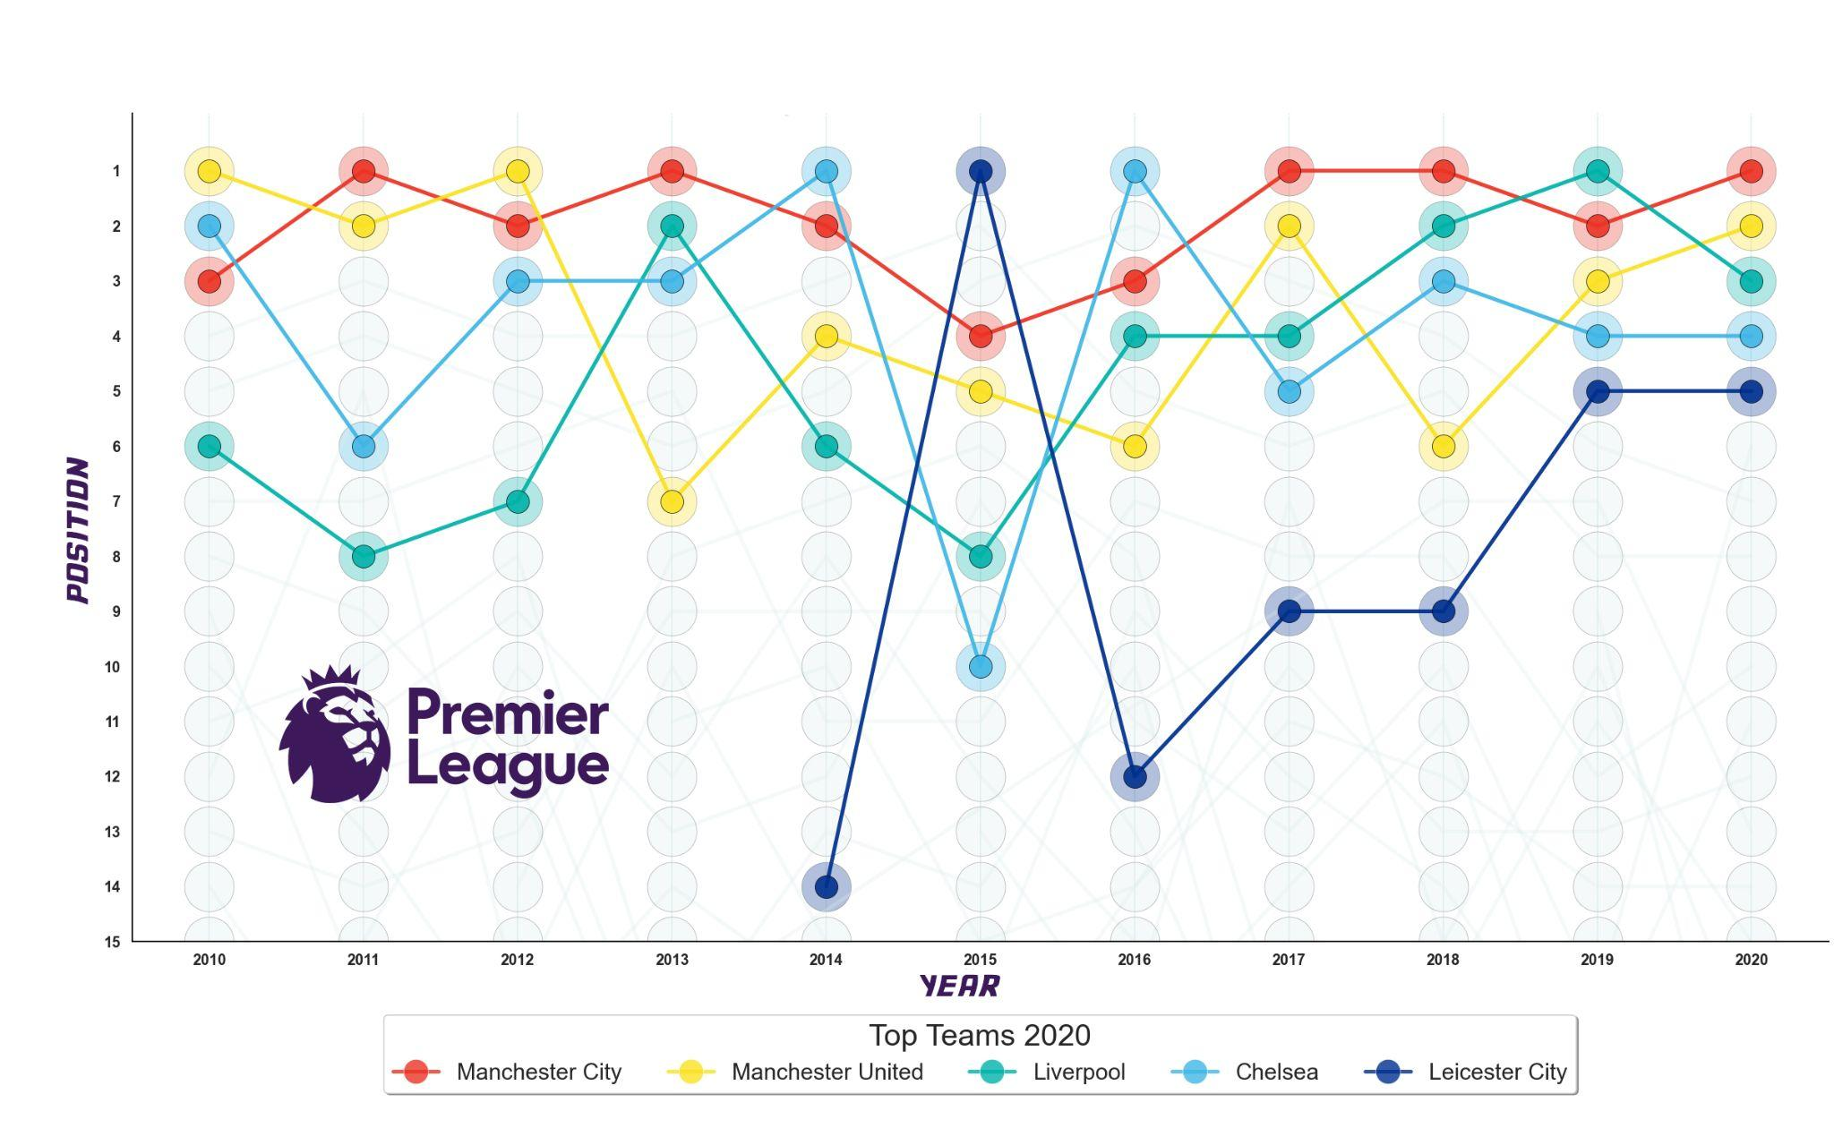

What are the trends in performance (Position) for the five most successful clubs of the Premier League over time (Years)

Slide 21
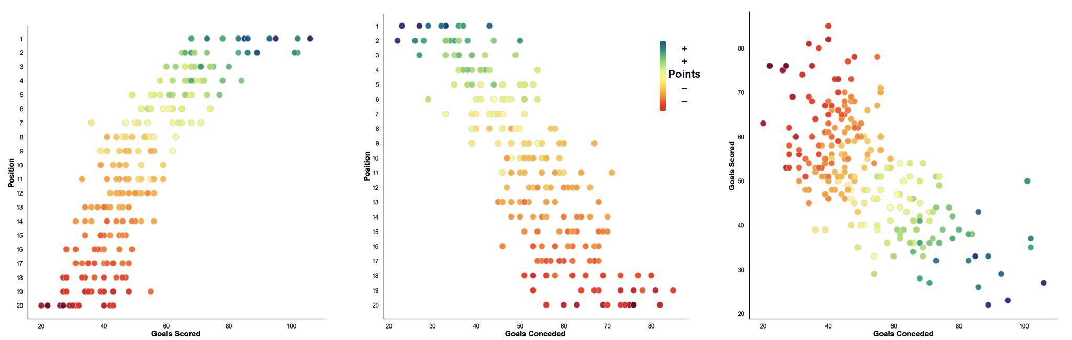
Understanding the relationship between
Goal scoring vs. Points and team Position

Slide 22

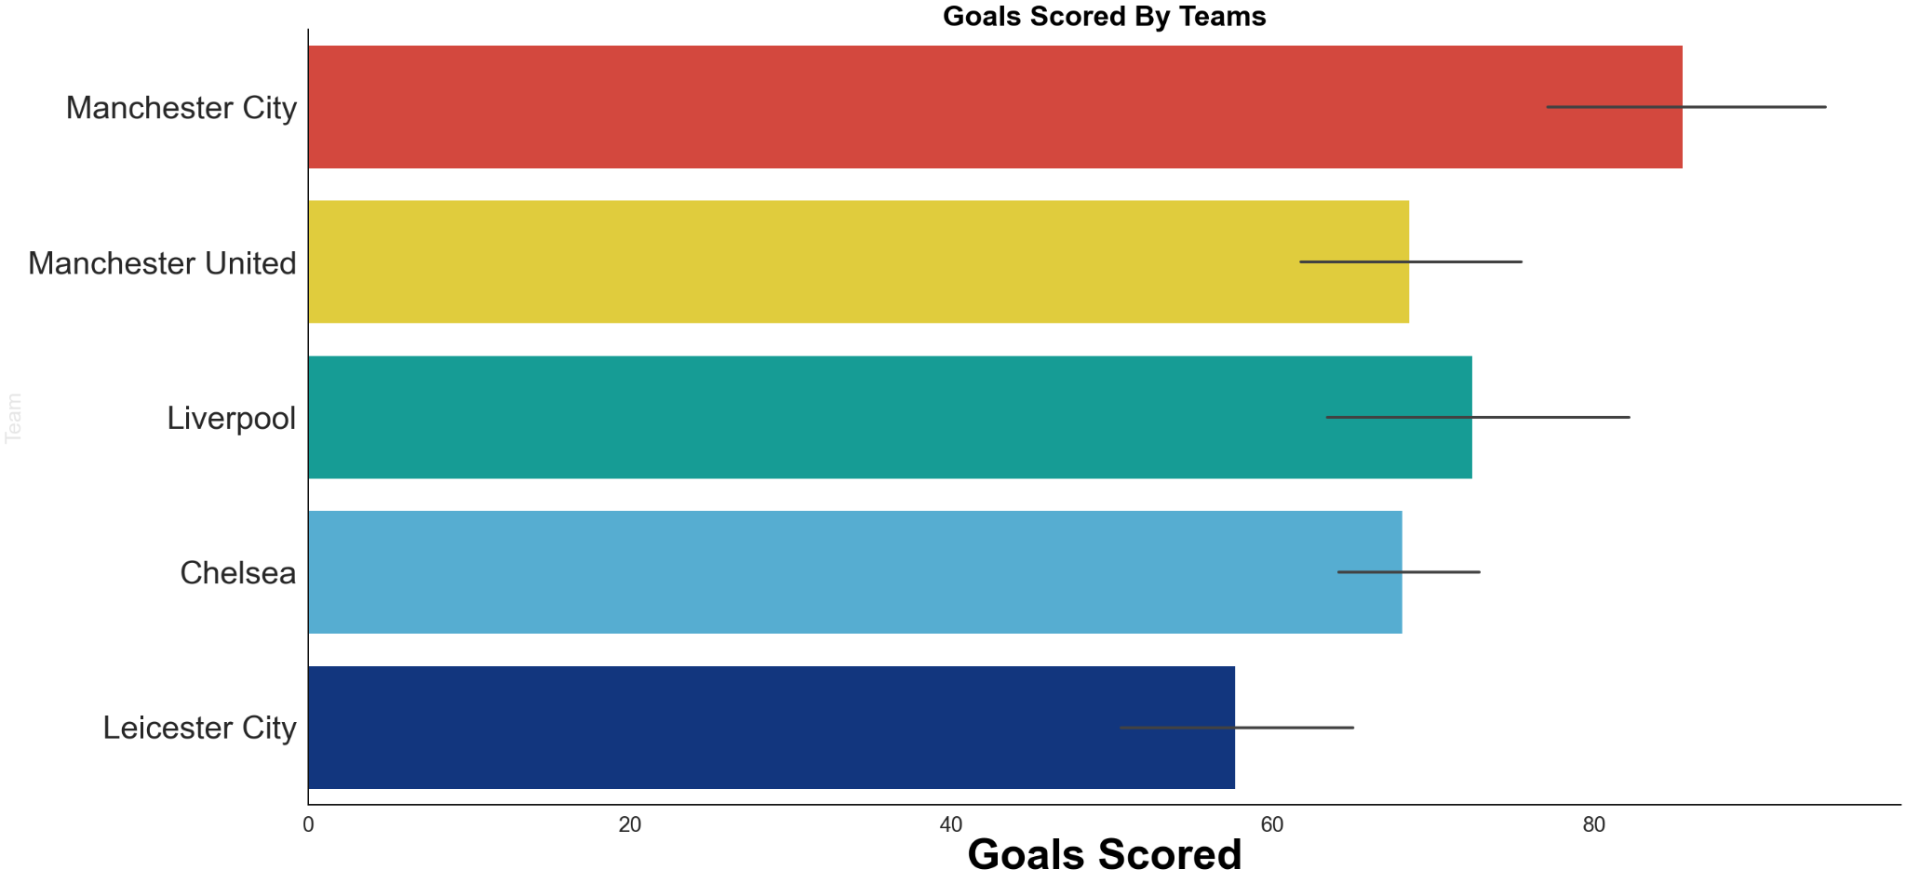
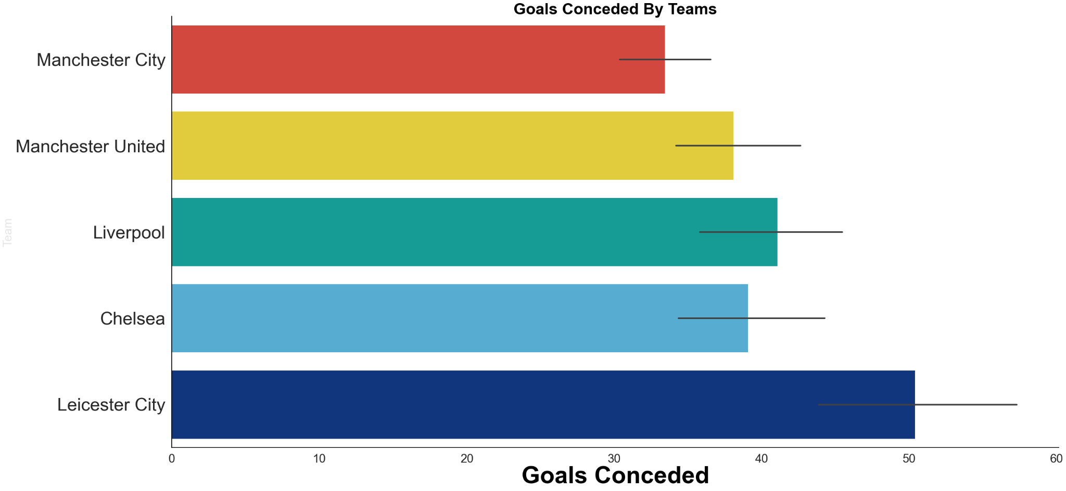
Which team of the top teams has the best attacking or defensive record in the last decade?

